Slide 1

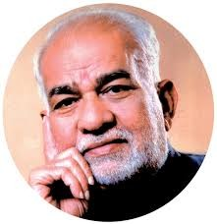
BVRIT HYDERABAD
College of Engineering for Women
Traffic Flow Forecast
Team No: 5
Sai Manasa - 20WH1A1282 Sanvitha-20WH1A1283 Sunidhi- 20WH1A1284 Manjula- 20WH1A1286 Aruna- 20WH1A1287

Slide 2
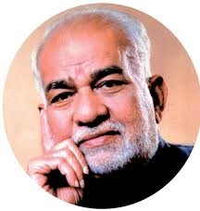
Table of Contents
Problem Statement Python Packages used Types of Algorithms used Algorithms
Output Comparison table

Slide 3
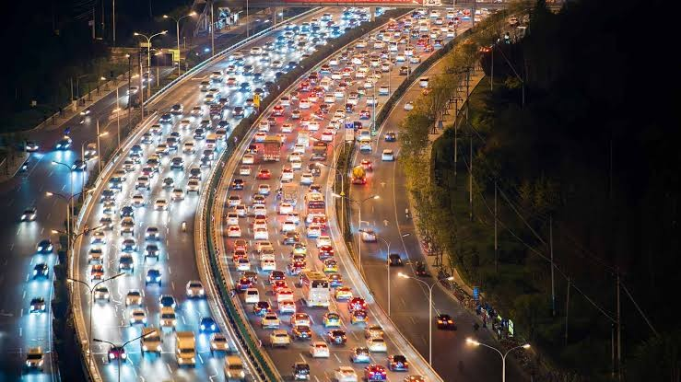
Problem Statement
You’ll forecast twelve-hours of traffic flow in a major
U.S. metropolitan area. Time, space, and directional features give you the chance to model interactions across a network of roadways. Submissions are evaluated on the mean absolute error between predicted and actual congestion values for each time period in the test set.

Slide 4
Python Packages used
Pandas Numpy
sklearn.ensemble sklearn.model selection sklearn

Slide 5
Random Forest Regression. K-means.
Types of Algorithms used

Slide 6
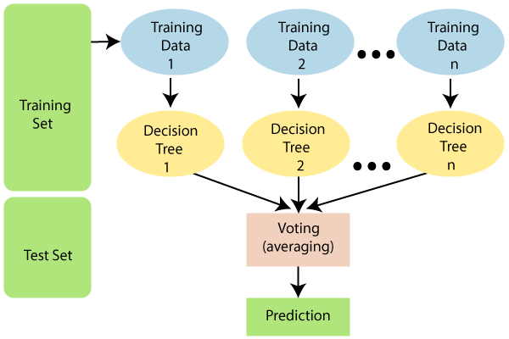
Algorithms
Random Forest Regression
Random Forest Regression is a machine learning algorithm that can be used for regression tasks. It is an ensemble learning method that combines multiple decision trees to make more accurate predictions.

Slide 7
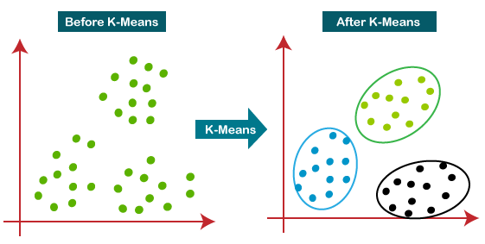
K-means
K-Means Clustering is an Unsupervised Machine Learning algorithm, which groups the unlabeled dataset into different clusters.

Slide 8
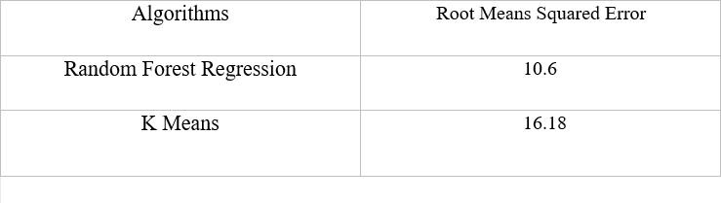
Comparison Table

Slide 9
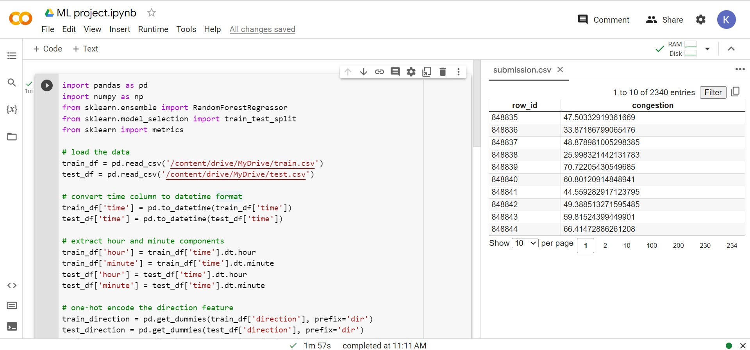
Output

Slide 10
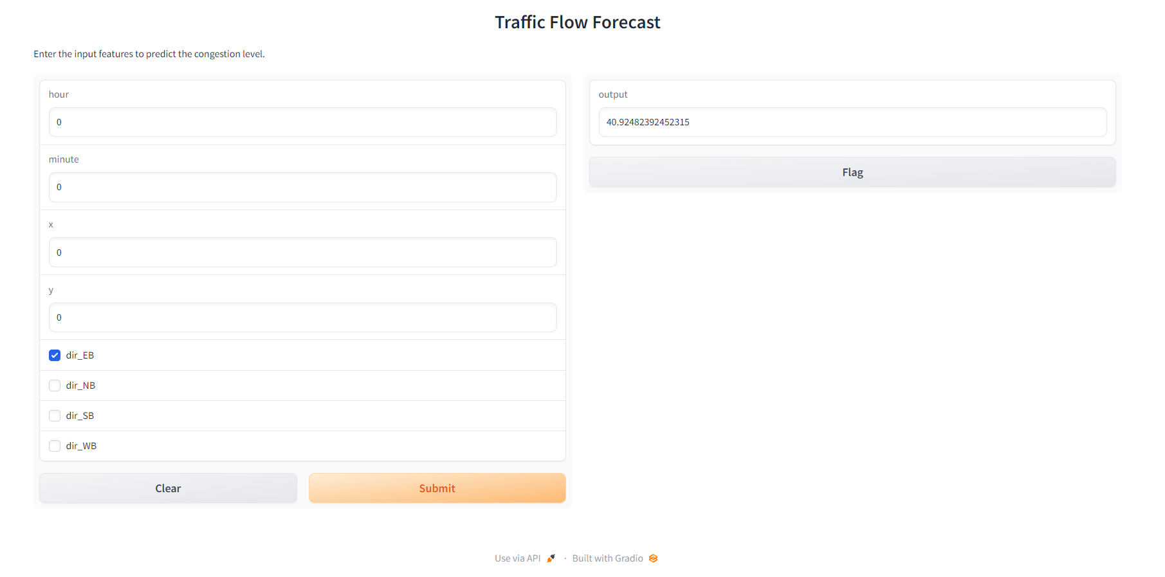

Slide 11
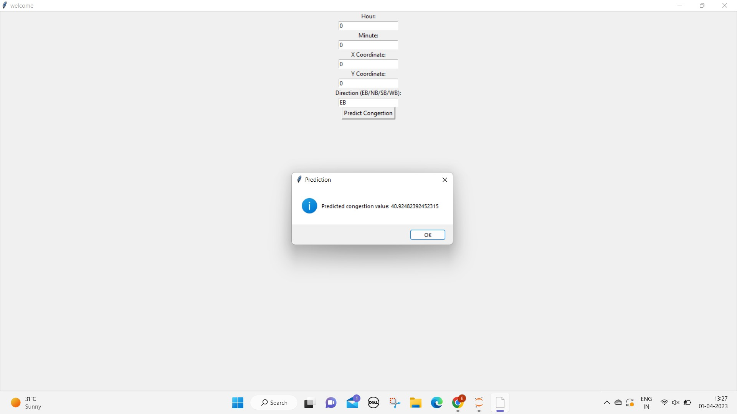

Slide 12
Thank You!

